Slide 1
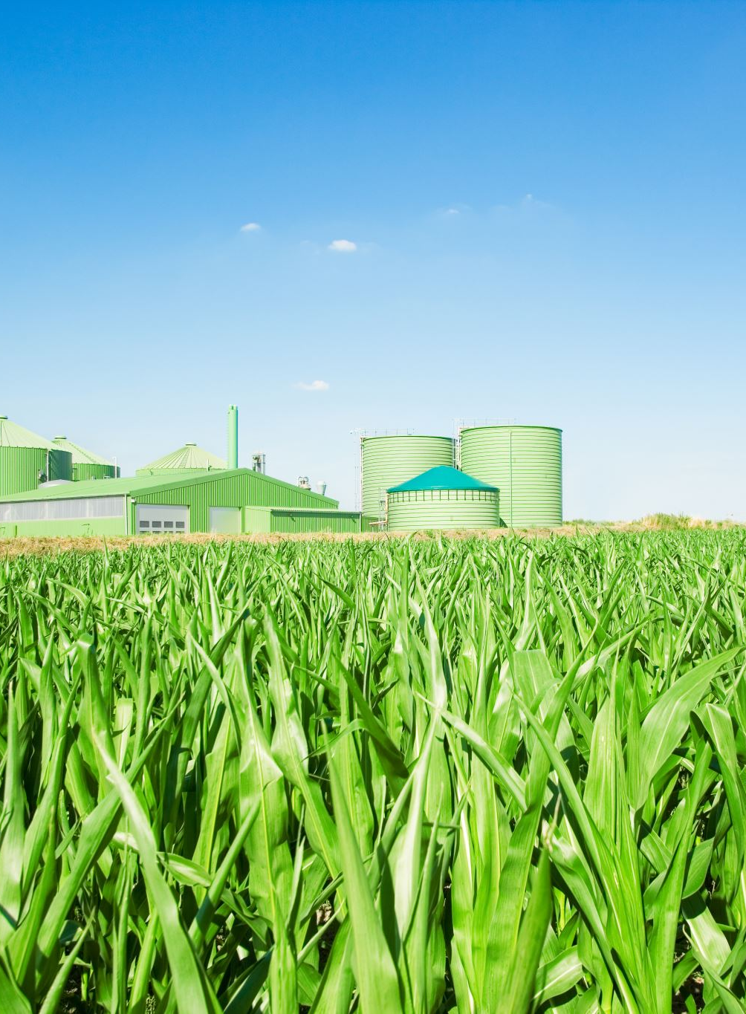
CROP RECOMMENDATION SYSTEM- AGRI ADVISOR
Presented By SAHAANA SG SWETHA M
(TWIN TECH) II AIDS S.A. Engineering College

Slide 2
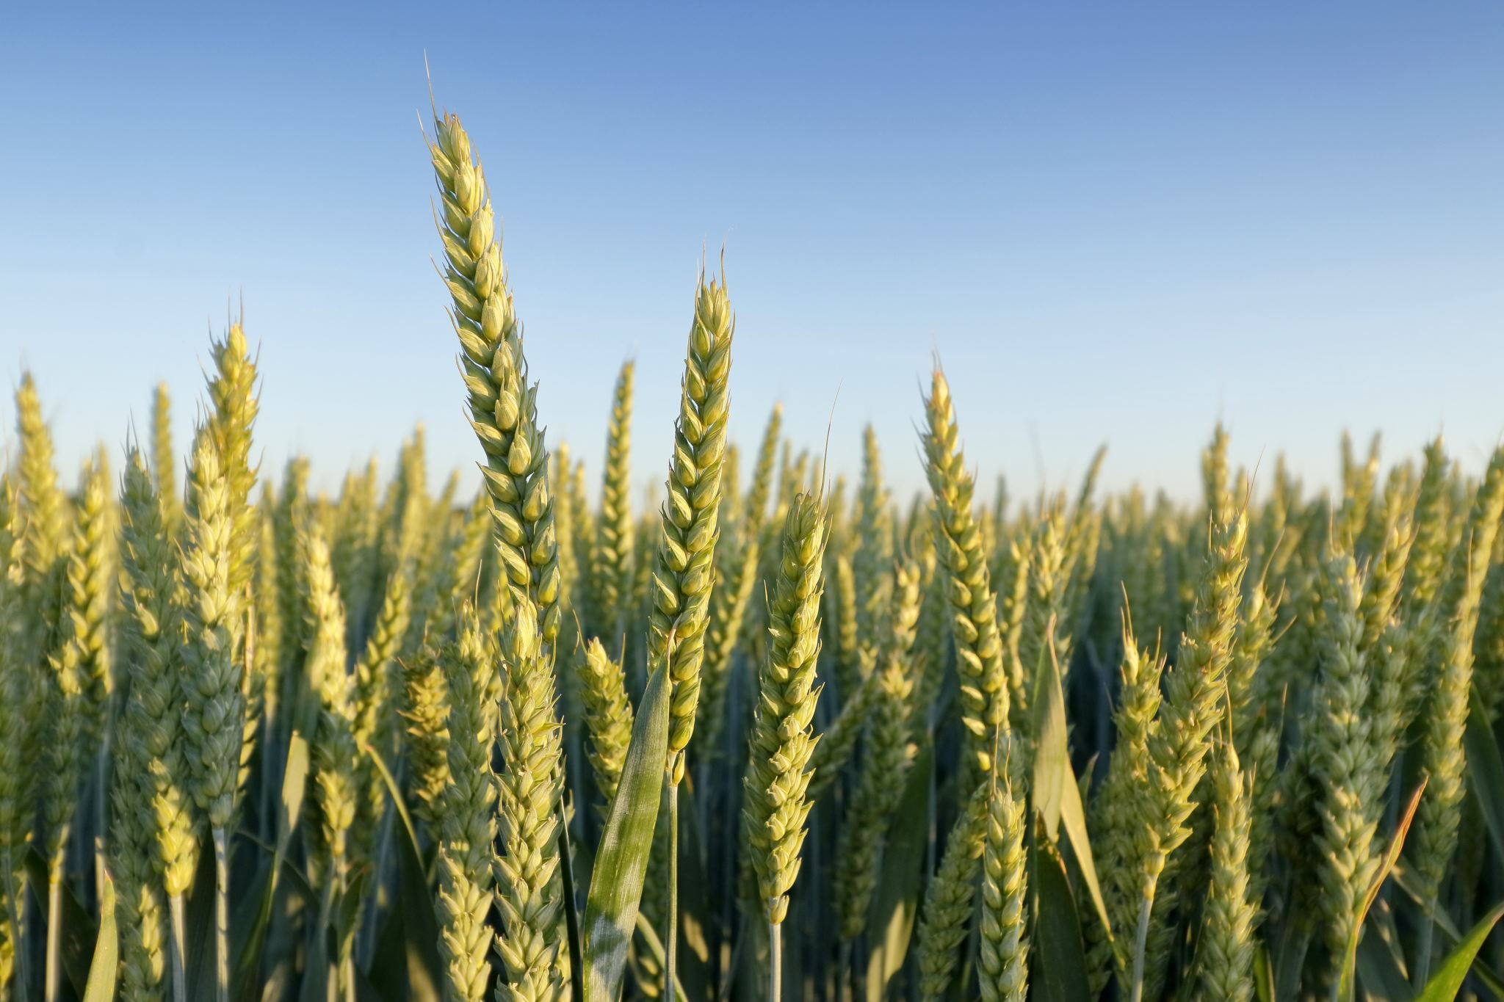
INTRODUCTION
Crop Recommendation Systems (CRS) are computer-based tools that help farmers make informed decisions about which crops to plant based on factors such as soil type, weather patterns, and historical crop yields.
The system uses parameters like nitrogen, phosphorous, potassium levels, temperature, humidity, pH , and rainfall to determine suitable crops. Its goal is to help farmers make informed decisions and maximize agricultural productivity.

Slide 3
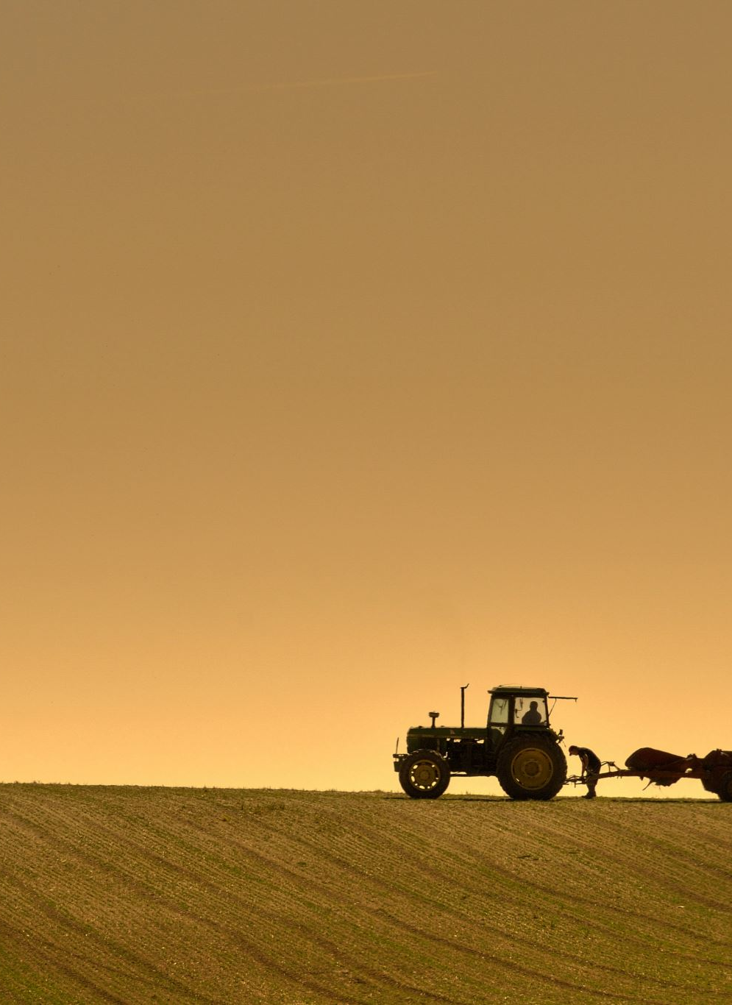
PROBLEM DEFINITION
Agriculture plays a crucial role in ensuring food security and economic stability in many countries.
However, the success of agricultural practices heavily depends on various factors such as soil quality, climate conditions, and crop suitability.
Farmers often face challenges in deciding which crops to cultivate based on these factors, leading to suboptimal yields and resource wastage.
To address this issue, there is a need for a Crop Recommendation System that can analyze environmental parameters and provide personalized crop recommendations to farmers.
This system aims to optimize crop selection, maximize productivity, and promote sustainable farming practices

Slide 4
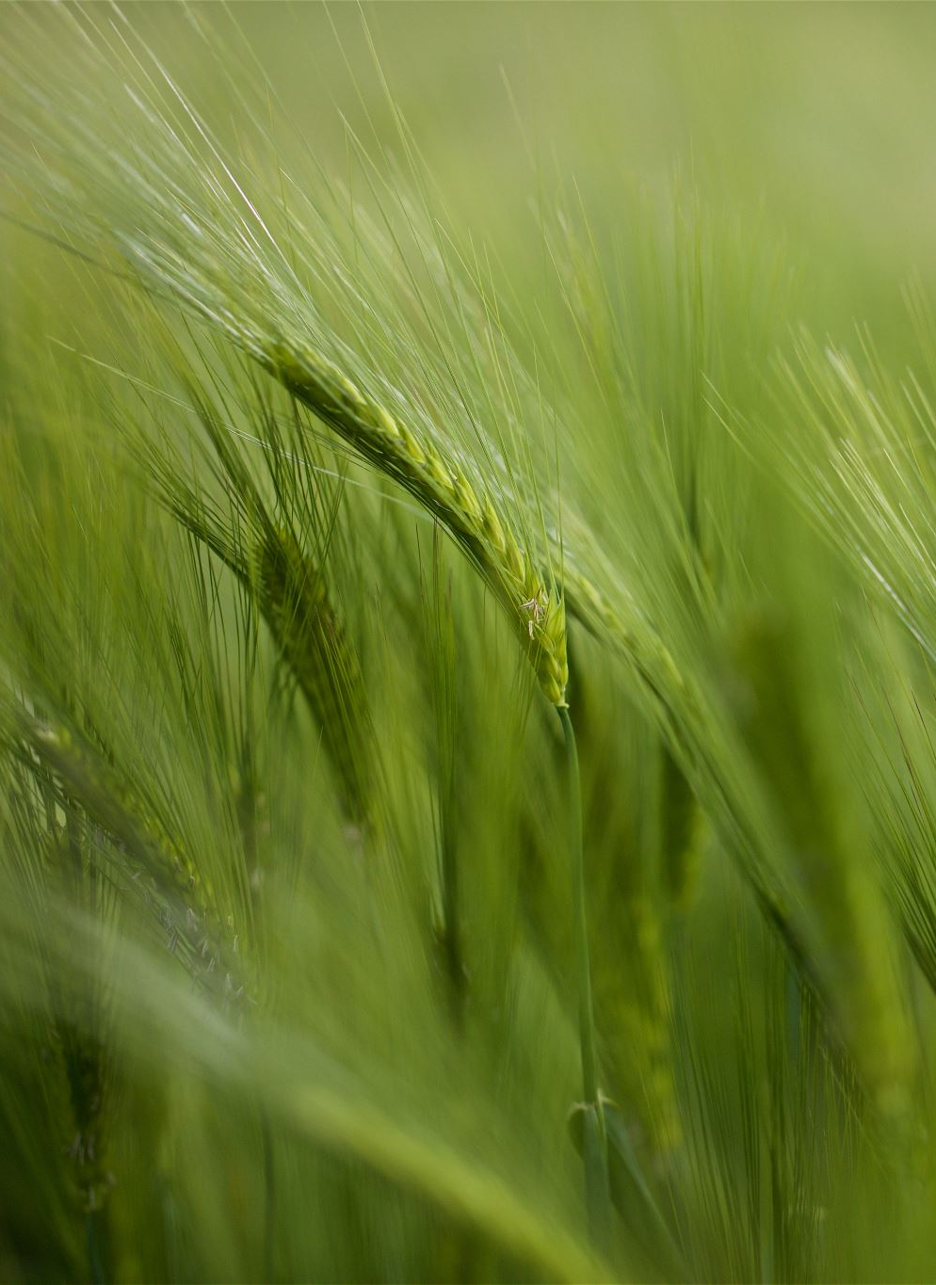
OBJECTIVE
To empower farmers with data-driven insights to make informed decisions about crop selection based on environmental factors such as soil quality, climate conditions, and historical crop performance.
Leveraging machine learning algorithms and agricultural data analytics
Aims to provide personalized recommendations tailored to the specific needs and constraints of individual farmers, ultimately optimizing crop yields, resource utilization, and economic returns.

Slide 5
NEED OF THE SYSTEM
The need for the Crop Recommendation System using Random Forest Classifier arises from the challenges faced by farmers in making informed decisions about crop selection.
Traditional methods often lack accuracy and fail to consider various factors affecting crop productivity.
By leveraging machine learning techniques, the system provides precise and data-driven recommendations based on factors such as soil composition, temperature, humidity, pH level, and rainfall.
This helps farmers optimize resource allocation, improve crop yield, minimize environmental impact, and make informed decisions for sustainable agricultural practices.
The system serves as a valuable tool to enhance productivity, profitability, and sustainability in the agriculture sector

Slide 6

SOFTWARE & TECHNOLOGY USED
Jupyter
Visual studio code
Flask
Sklearn
Random Forest Classifier
HTML & Bootstrap
Kaggle

Slide 7
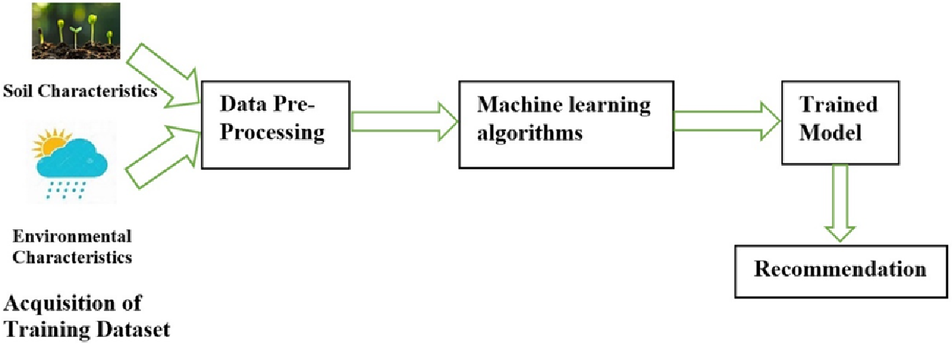
BLOCK DIAGRAM

Slide 8

WORKING PRINCIPLE
DATASET COLLECTION:
The system begins by importing the data. This data can include information on:
Crop types , Soil parameters like pH, nitrogen content, phosphorous content, and potassium content , humidity
PREPROCESSING:
Once collected, the data goes through preprocessing. This step cleans and organizes the data to ensure the machine learning model can understand it.
After preprocessing, the data is used to create a machine learning model. The specific algorithm chosen depends on the data and the desired outcome.
MACHINE LEARNING ALGORITHMS:
A machine learning model is selected and trained on the pre-processed data. The model learns to identify patterns and relationships within the data.

Slide 9
WORKING PRINCIPLE
MODEL TRAINING :
the model is trained on the preprocessed data. During training, the model learns the relationships between the input features (soil parameters, crop types, etc.) and the target variable (crop yield or suitability).
USER INPUT:
After training, the model is integrated into the web application. Users can then input data about their specific field, such as soil composition and rainfall.
CROP RECOMMENDATION:
The user-provided data is fed into the trained model. The model then makes predictions about which crops are best suited for the user's field, considering factors like soil conditions, climate, and historical crop yields.

Slide 10

What is random forest classifier?
A random forest classifier is a powerful machine learning algorithm that uses a bunch of decision trees to make predictions. Imagine a forest where each tree makes a decision based on certain features, and by combining the votes of all the trees, you get a much more robust prediction than any single tree could make on its own.

Slide 11
Why we are using random forest classifier
Random Forest classifier is commonly used in crop recommendation systems due to its effectiveness in handling high-dimensional data, handling both numerical and categorical variables, and robustness against overfitting. In the context of crop recommendation, it can analyze various factors such as soil type, climate, topography, and historical crop yields to suggest the most suitable crops for a particular area. Additionally, Random Forests provide feature importance scores, which can help users understand the factors influencing the recommendations.

Slide 12
ADVANTAGES:
Increased yields: By considering factors like soil composition, weather patterns, and historical data, these systems can recommend crops that are best suited to a particular field. This can lead to higher crop yields and a better return on investment for farmers.
Improved resource management: Crop recommendation systems can also help farmers optimize their use of resources like water, fertilizer, and pesticides. This can not only save farmers money but also reduce the environmental impact of agriculture.
Reduced risk: By helping farmers choose crops that are less likely to be affected by pests or diseases, crop recommendation systems can help to reduce risk.
Promotes sustainable practices: These systems can suggest crop rotations that help improve soil health and reduce reliance on chemical inputs.
Better decision-making: Crop recommendation systems provide farmers with data-driven insights that can help them make more informed decisions about their crops.
Increased profitability: By considering factors like market prices, crop recommendation systems can help farmers select crops that are likely to be the most profitable.

Slide 13

DISADVANTAGES:
Data dependence: Relies on accurate data like soil quality, weather, and historical yields. Poor data leads to bad recommendations.
Limited scope: Might not account for unexpected factors like sudden weather changes or pest outbreaks.
Farmer knowledge: Farmers still need knowledge to interpret recommendations and adapt them to their specific circumstances.

Slide 14
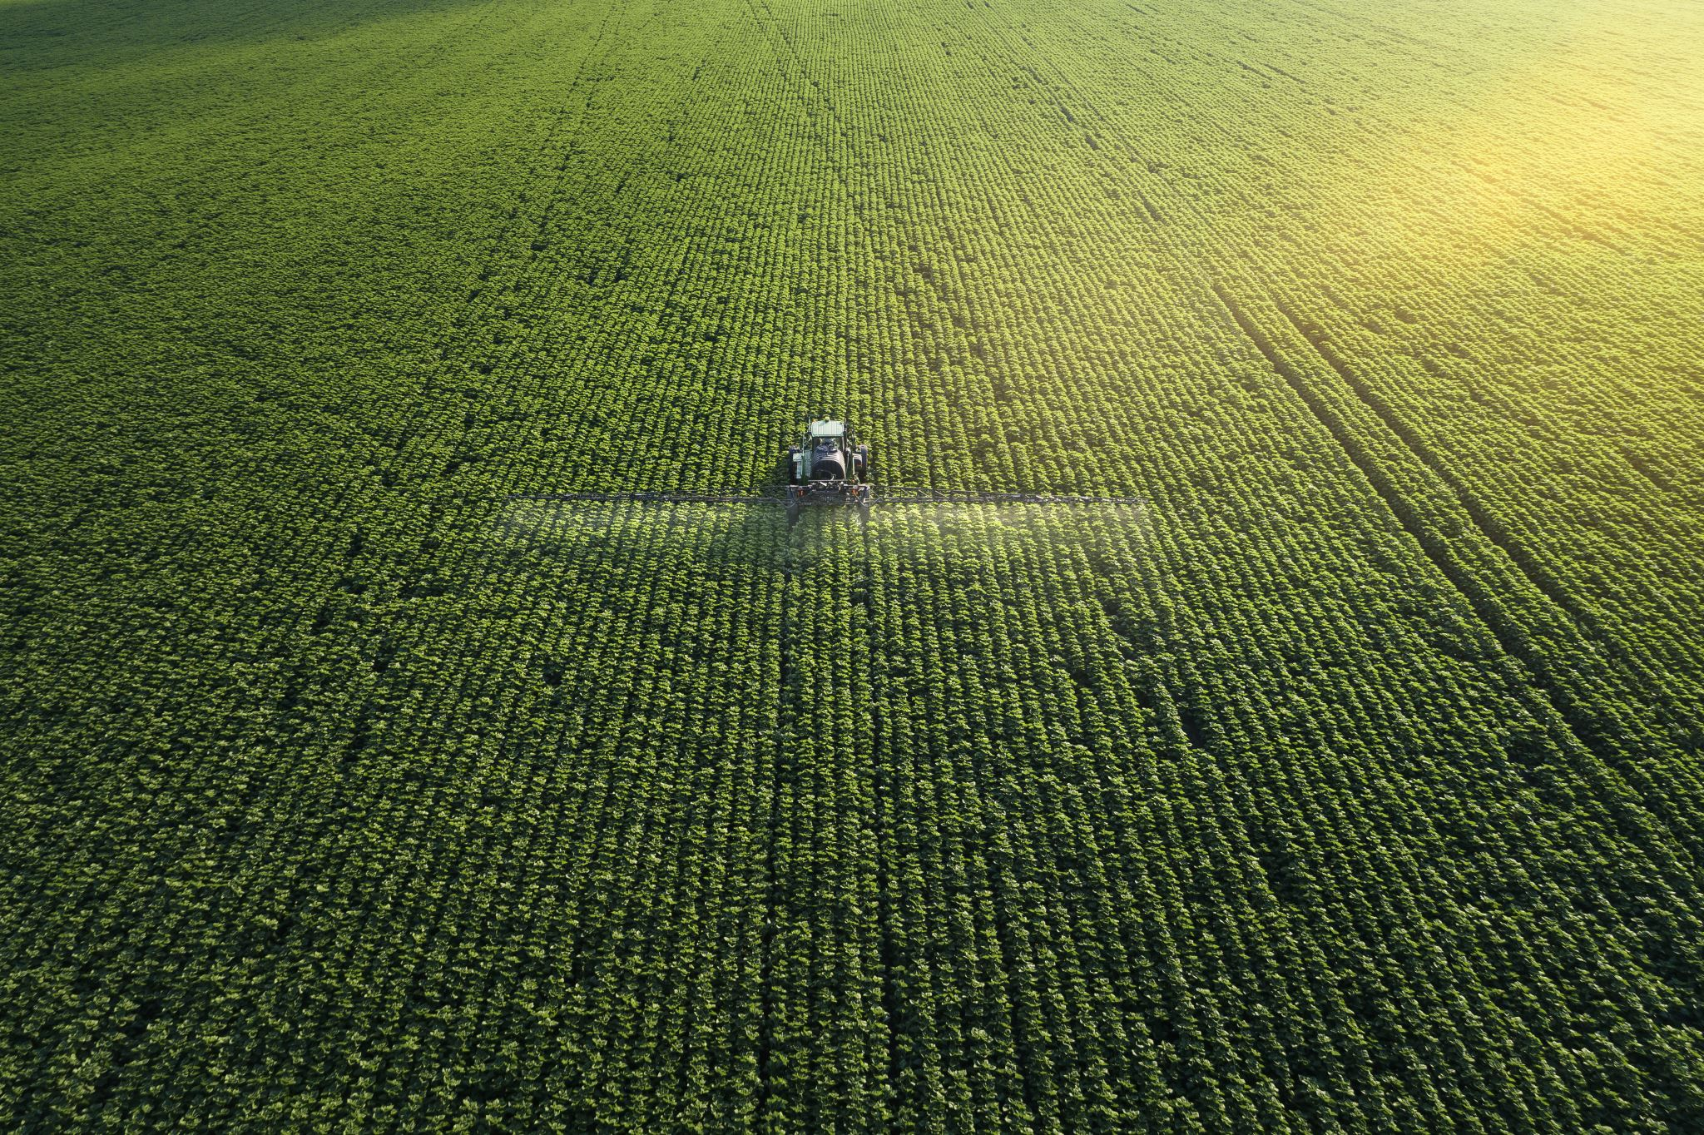
FUTURE SCOPE
The future scope of Crop Recommendation Systems using Random Forest Classifier includes improving accuracy through advanced algorithms and technologies, personalizing recommendations based on individual preferences and farm conditions, integrating climate change adaptation strategies, developing mobile applications for enhanced accessibility, fostering knowledge sharing and collaboration, expanding to different regions and crops, and incorporating decision support tools. These advancements aim to optimize agricultural practices, increase productivity, and address emerging challenges in the agricultural sector

Slide 15
CONCLUSION
In conclusion, a crop recommendation system holds tremendous promise for revolutionizing agricultural practices by leveraging data analytics, machine learning algorithms, and agronomic expertise to provide tailored recommendations to farmers based on various factors such as soil health, weather patterns, historical yields, and market demands. By optimizing crop selection and management strategies, such systems can significantly enhance yields, resource efficiency, and profitability for farmers while promoting sustainable agricultural practices. However, their success hinges on the accuracy of underlying data, the robustness of algorithms, and ensuring accessibility to farmers, particularly in remote areas. Continuous refinement and adaptation are crucial to meet evolving agricultural challenges, but overall, crop recommendation systems have the potential to play a pivotal role in ensuring global food security and sustainability.d

